Slide 1

Computational Biology & Bioinformatics
Prof. Dominic Evangelista
Adelphi University
Fall 2021

Slide 2
Definitions
Bioinformatics: Research, development, or application of computational tools and approaches for expanding the use of biological, medical, behavioral or health data, including those to acquire, store, organize, archive, analyze, or visualize such data.
Computational Biology: The development and application of data-analytical and theoretical methods, mathematical modeling and computational simulation techniques to the study of biological, behavioral, and social systems
NIH definitions (2000)

Slide 3
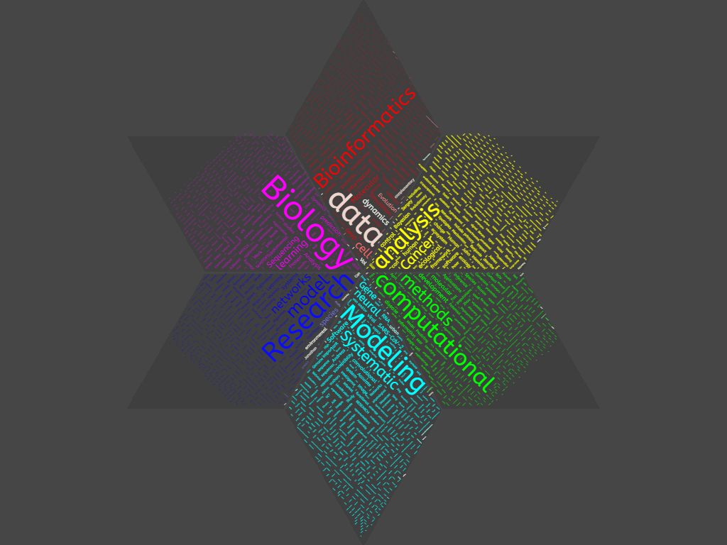
Notes:
Made this word cloud by pasting text from article titles and descriptions of journals that publish computational biology and related papers (e.g., Journal of Computational Biology, PLOS Computational Biology, Bioinformatics, Ecoinformatics, Journal of Systematic Biology)

Slide 4
Notes:
Made this word cloud by pasting text from article titles and descriptions of journals that publish computational biology and related papers (e.g., Journal of Computational Biology, PLOS Computational Biology, Bioinformatics, Ecoinformatics, Journal of Systematic Biology)

Slide 5
Notes:
Made this word cloud by pasting text from article titles and descriptions of journals that publish computational biology and related papers (e.g., Journal of Computational Biology, PLOS Computational Biology, Bioinformatics, Ecoinformatics, Journal of Systematic Biology)

Slide 6
All biology is becoming computational, much the same way it has became molecular … Otherwise “low input, high throughput and no output science”
--- Sydney Brenner
2002 Nobel Prize

Slide 7
Bioinformatics and Computational Biology
Interdisciplinary
Statistics, Biology, Computer Science
Applied
From freshman to postdocs
Useful training for many
The more you practice, the better you get
Moves with technology development

Slide 8
Why use computational methods?
Data is big
Problems are hard
Novel technology requires novel solutions

Slide 9
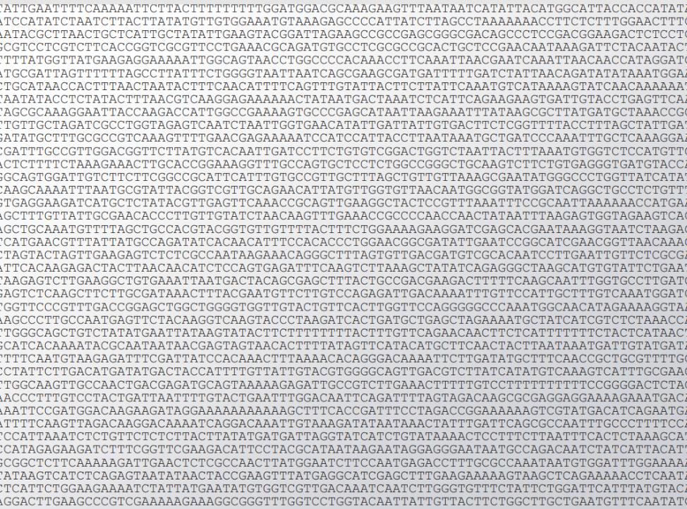
Data is big

Slide 10
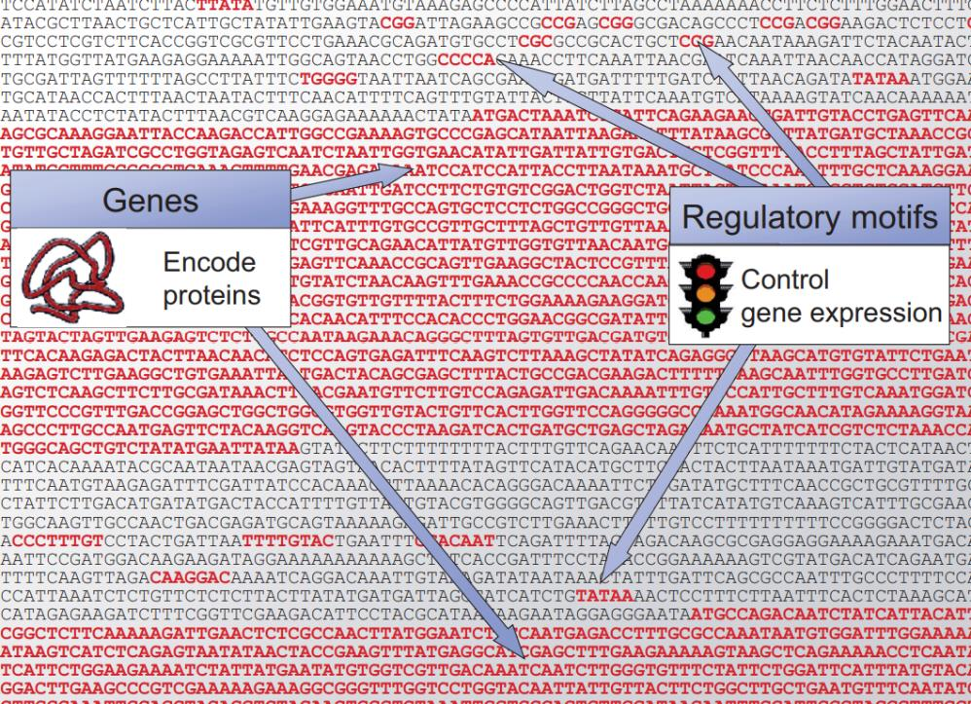
Data is big

Slide 11
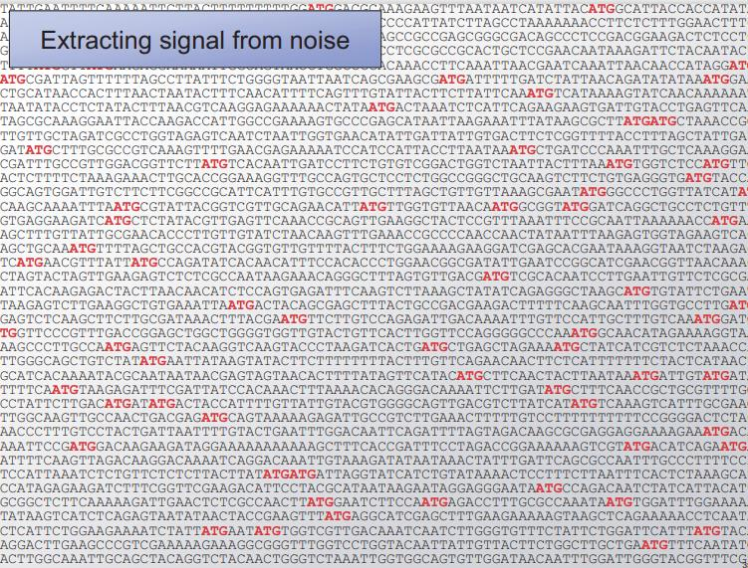
Problems are hard
Notes:
ATG is the “start” codon

Slide 12
Problems are hard
A
A
C
B
B
C
3 tips in the (rooted) tree
3 different possible trees
B
C
A

Slide 13
Problems are hard
A
A
D
D
D
B
B
C
B
B
C
D
B
C
A
D
C
A
A
C
A
A
D
C
C
C
B
D
A
D
B
B
A
A
D
D
C
B
4 tips in the (rooted) tree
12 different possible trees
B
C
C
C
B
B
A
D
D
A

Slide 14
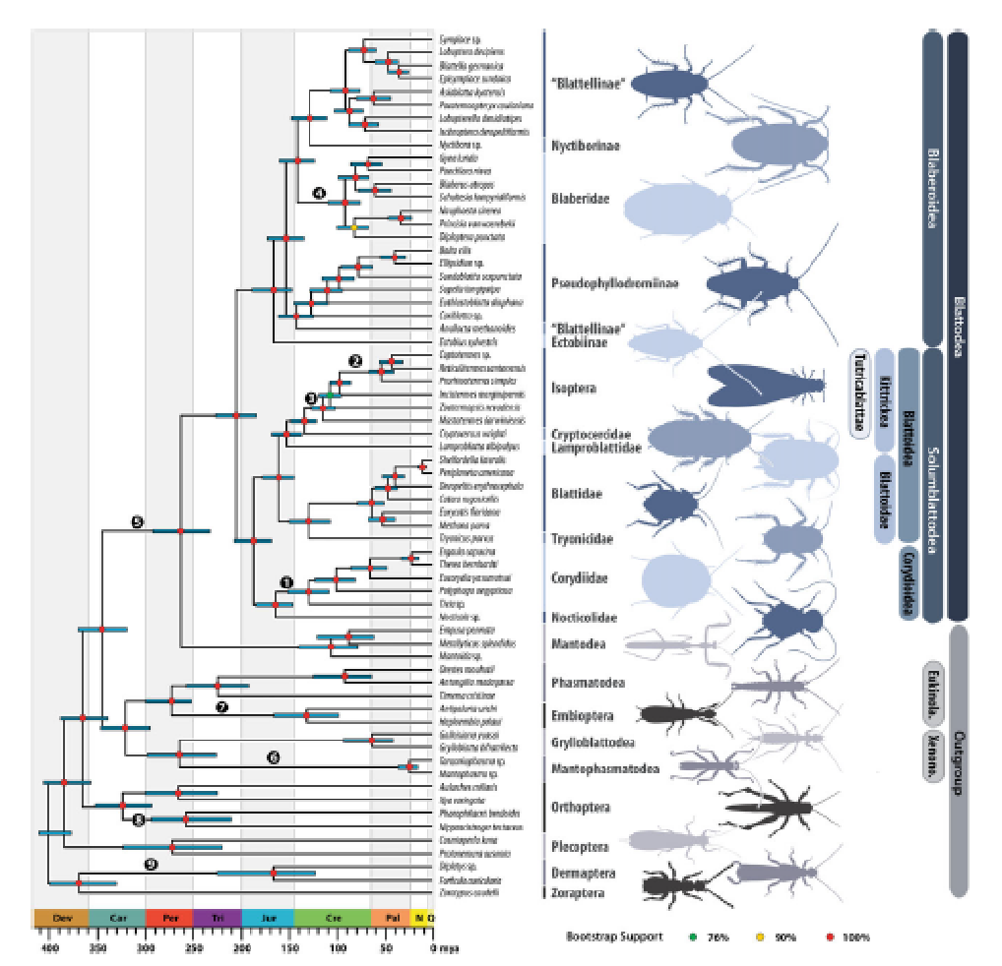
Problems are hard
QUESTION: In a tree with 64 tips, the number of possible trees is…
128
4096
64!
a number greater than the number of protons in all of the molecules of the visible universe
5*10¹⁷
Evangelista et al (2019), a Phylogeny of cockroaches has 64 tips (species)

Slide 15

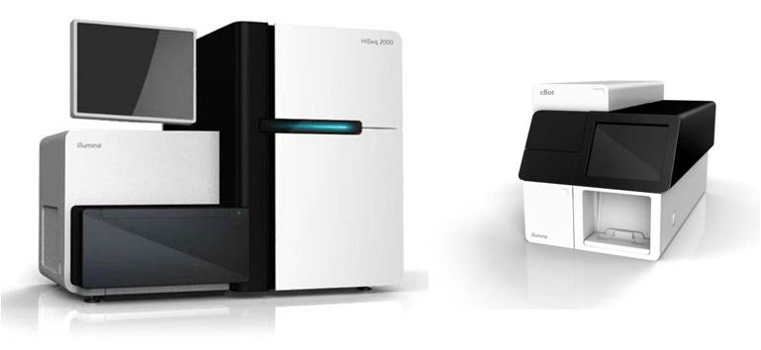
Novel technology requires novel solutions
600 million reads which can be multiplexed to sequence hundreds of species simultaneously
Hilma af Klint – Paintings for the temple series (~1907)

Slide 16
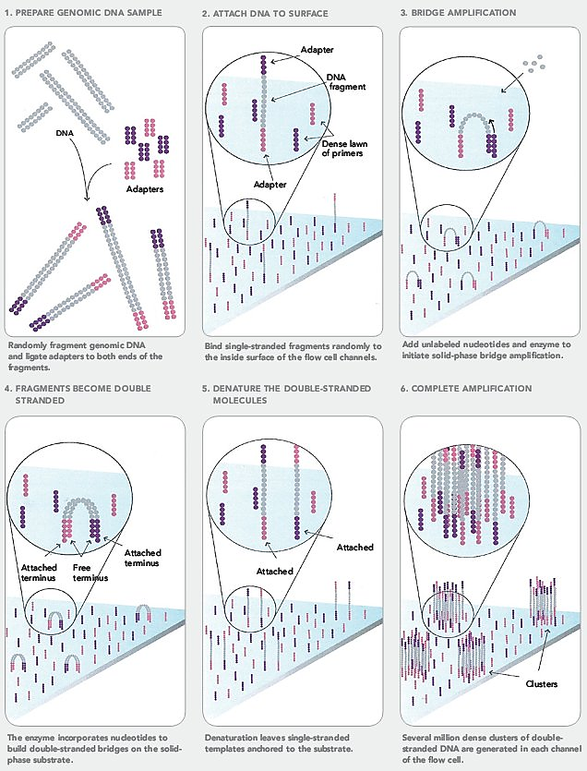
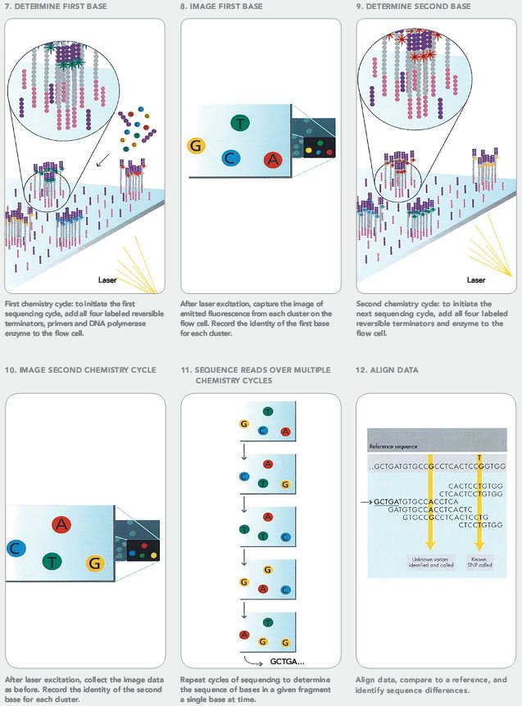
Notes:
Machine costs between 10’s and 100’s of thousands of dollars (nova seq on ebay range from $550K-2.5million)

Slide 17
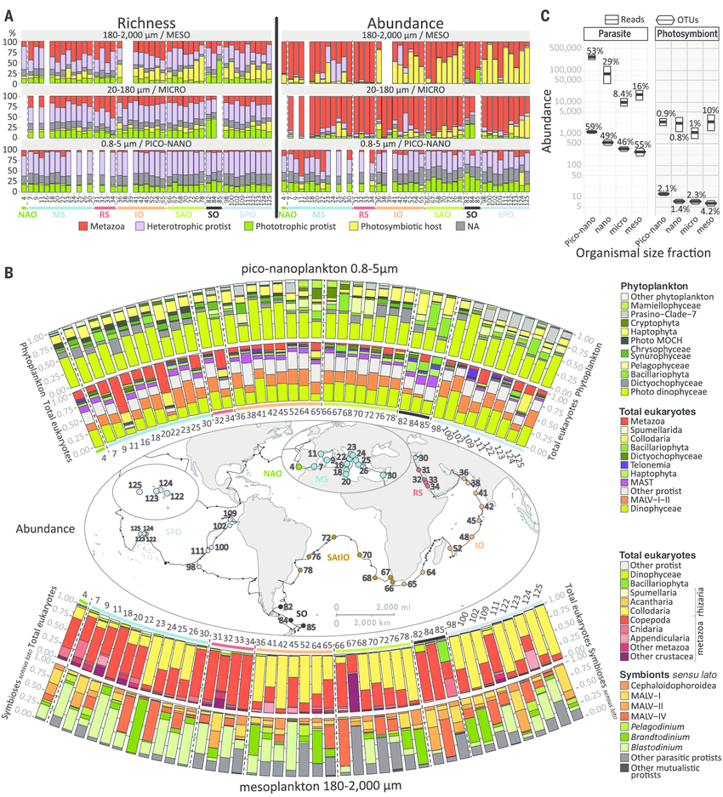
Novel technology requires novel solutions
Novel sequencing technologies allow old questions to be answered in new ways BUT we need new computational methods to handle them
Notes:
Figure caption. Metabarcoding inference of trophic and symbiotic ecological diversity of photic-zone eukaryotic plankton. (A) Richness (OTU number) and abundance (read number) of rDNA metabarcodes assigned to various trophic taxo-groups across plankton organismal size fractions and stations. Note that the nano size fraction did not contain enough data to be used in this biogeographical analysis [for all size-fraction data, see (30)]. NA, not applicable. (B) Relative abundance of major eukaryotic taxa across Tara Oceans stations for (i) phytoplankton and all eukaryotes in piconanoplankton (above the map) and (ii) all eukaryotes and protistan symbionts (sensu

Slide 18
https://github.com/dominicev/Phyloinformatica

Slide 19
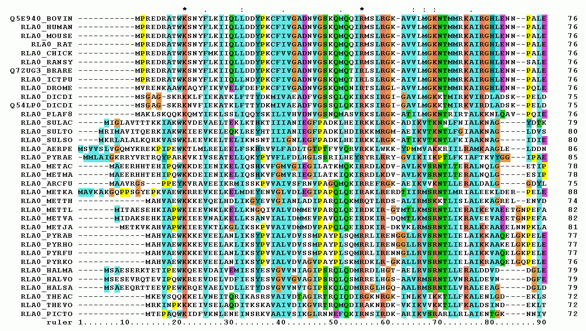
Examples of computational biology problems
Multiple sequence alignment (homology searching)

Slide 20
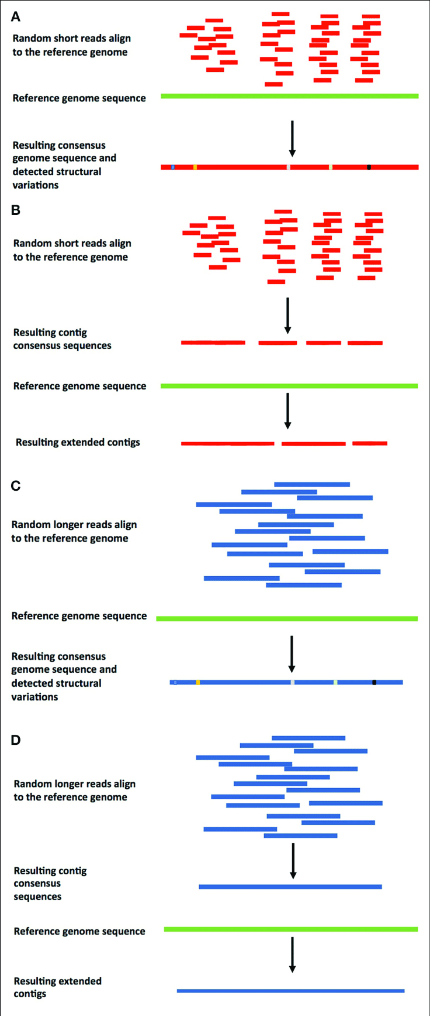
Examples of computational biology problems
Assembling sequenced genomes

Slide 21
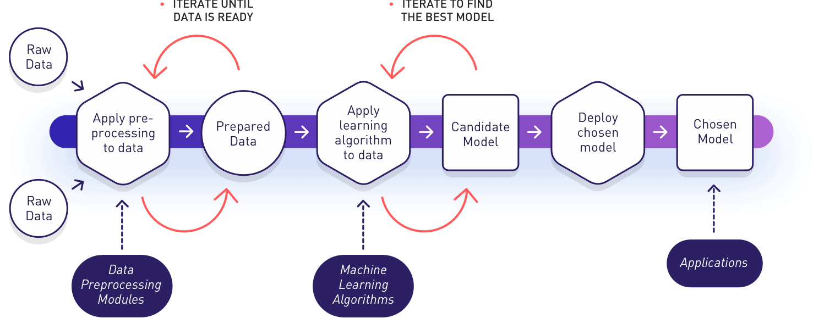
Examples of computational biology problems
Classify novel data using known data (machine learning)

Slide 22
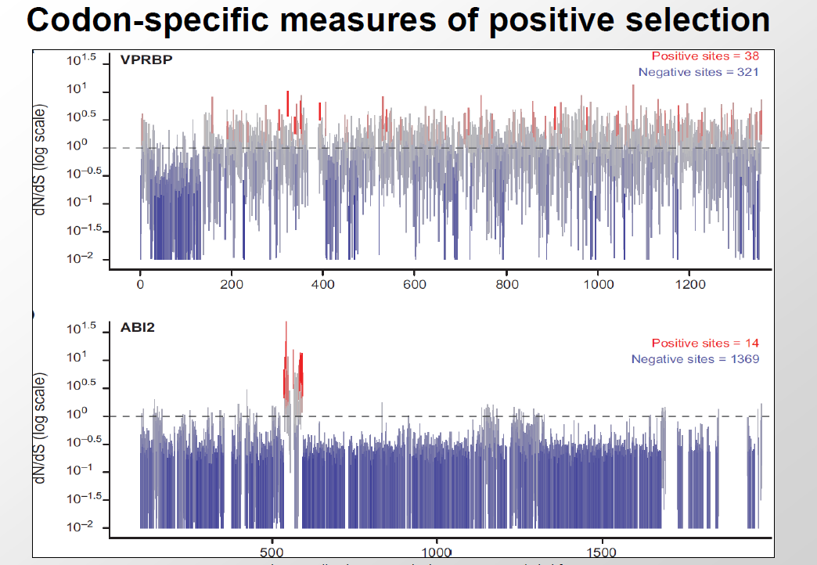
Examples of computational biology problems
Comparative genomics

Slide 23
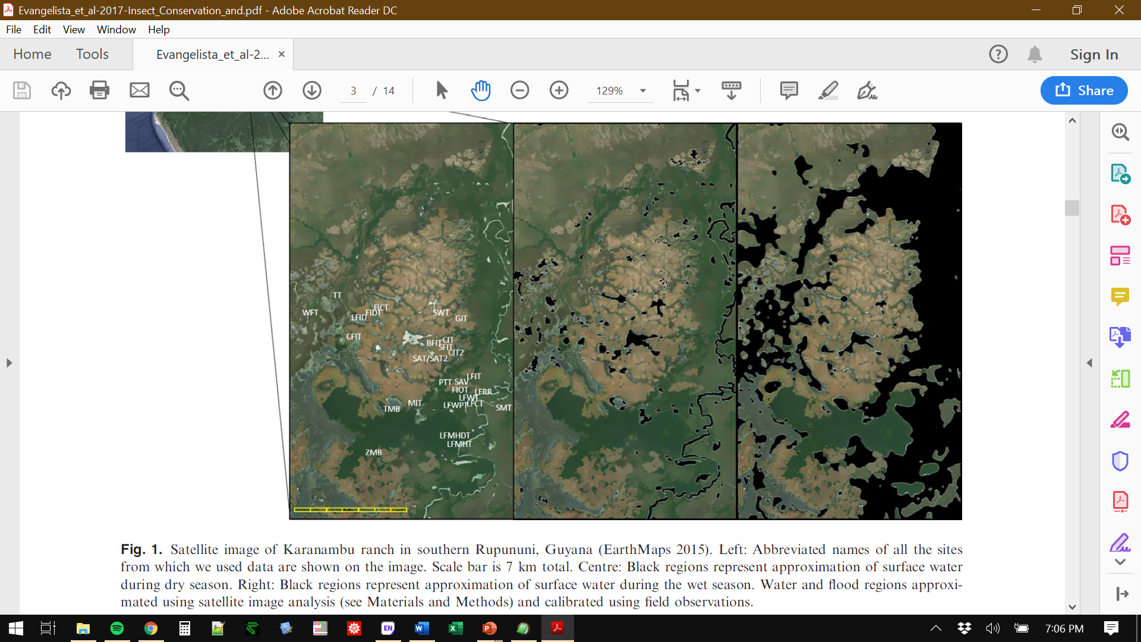
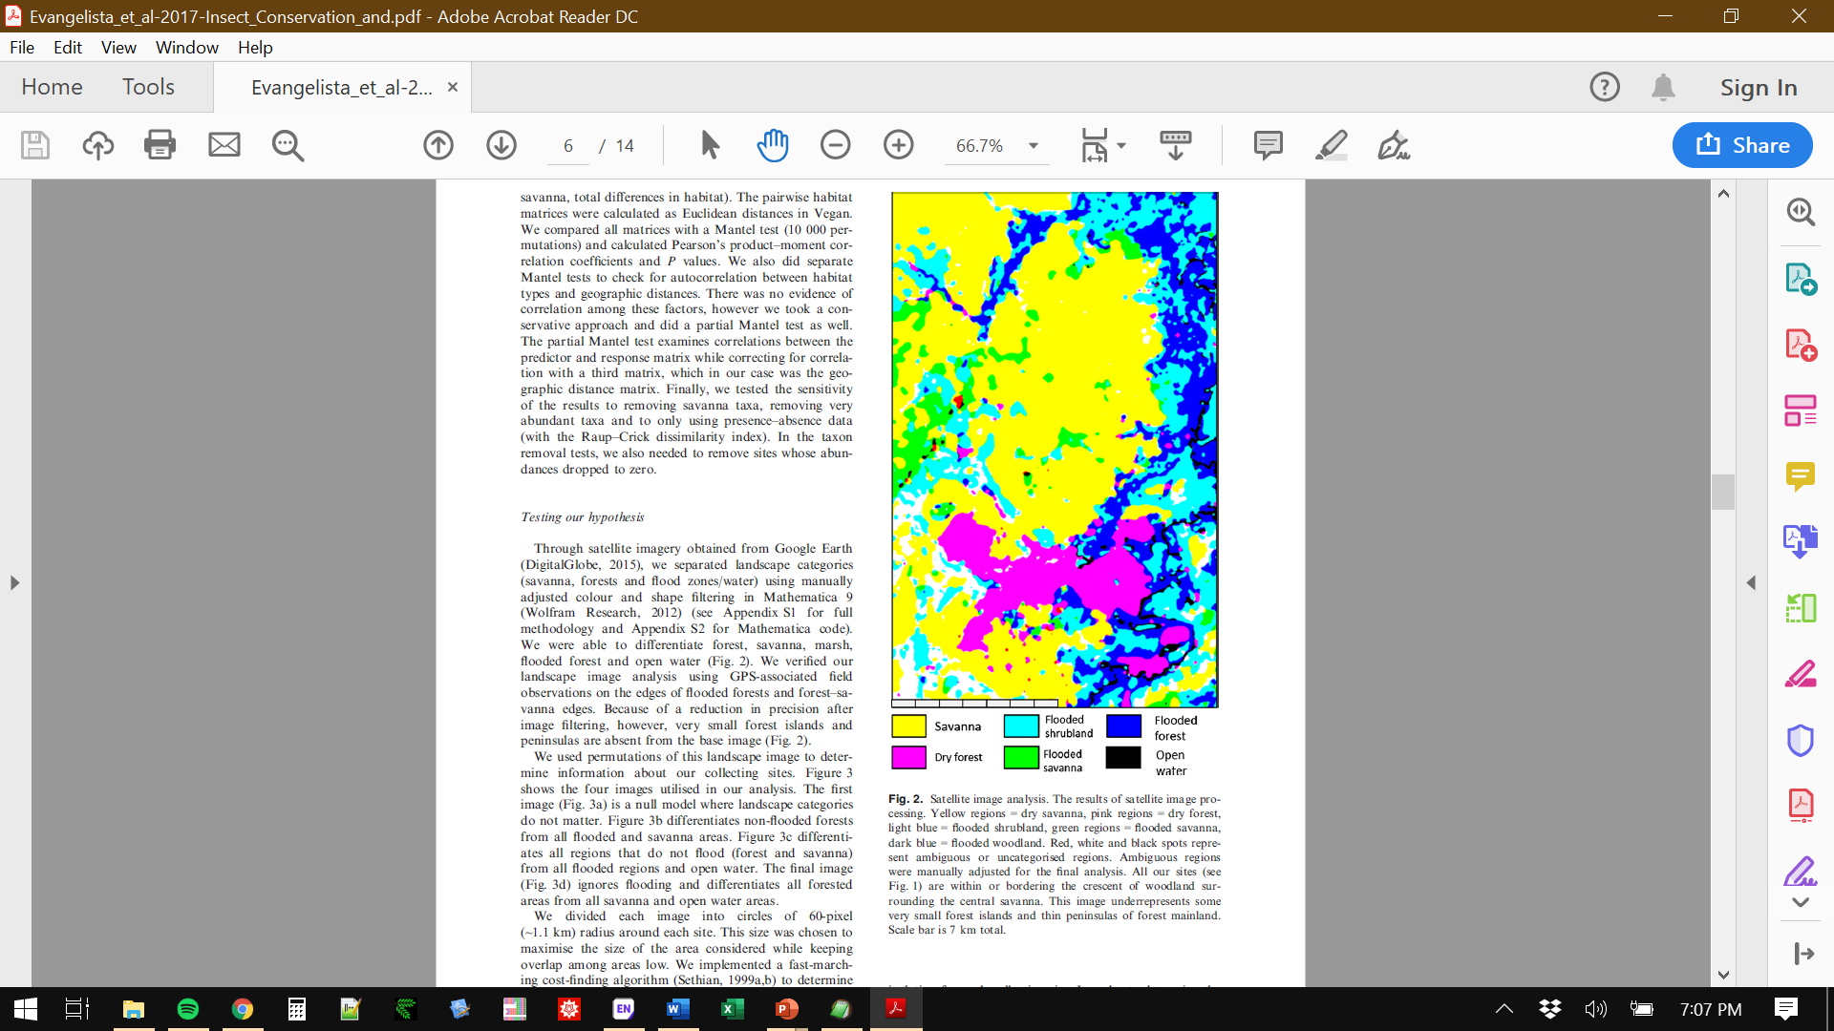
Examples of computational biology problems
Remote sensing
Reality
Model
Representation

Slide 24
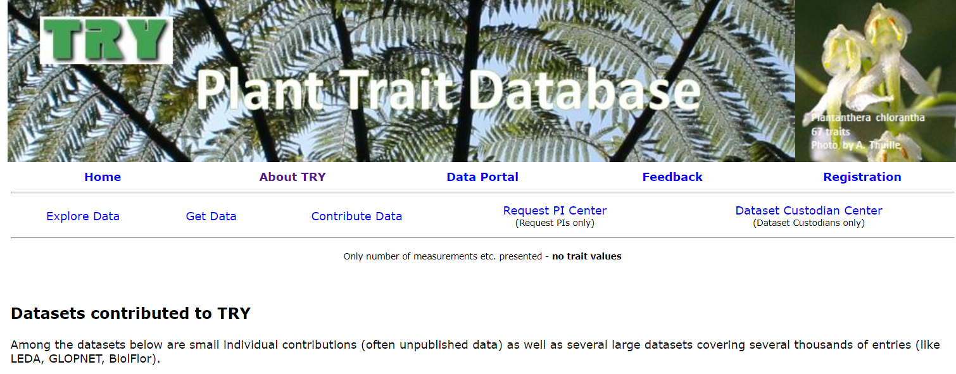
Examples of computational biology problems
Analysis of large ecological datasets

Slide 25
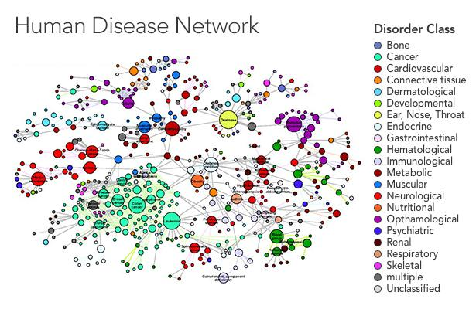
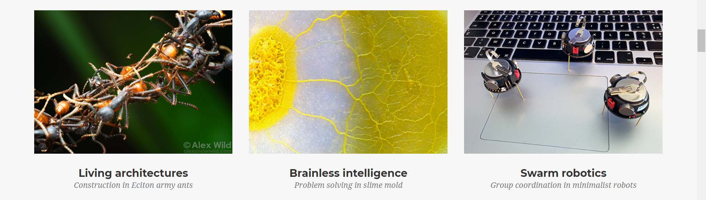
Examples of computational biology problems
Network analysis

Slide 26
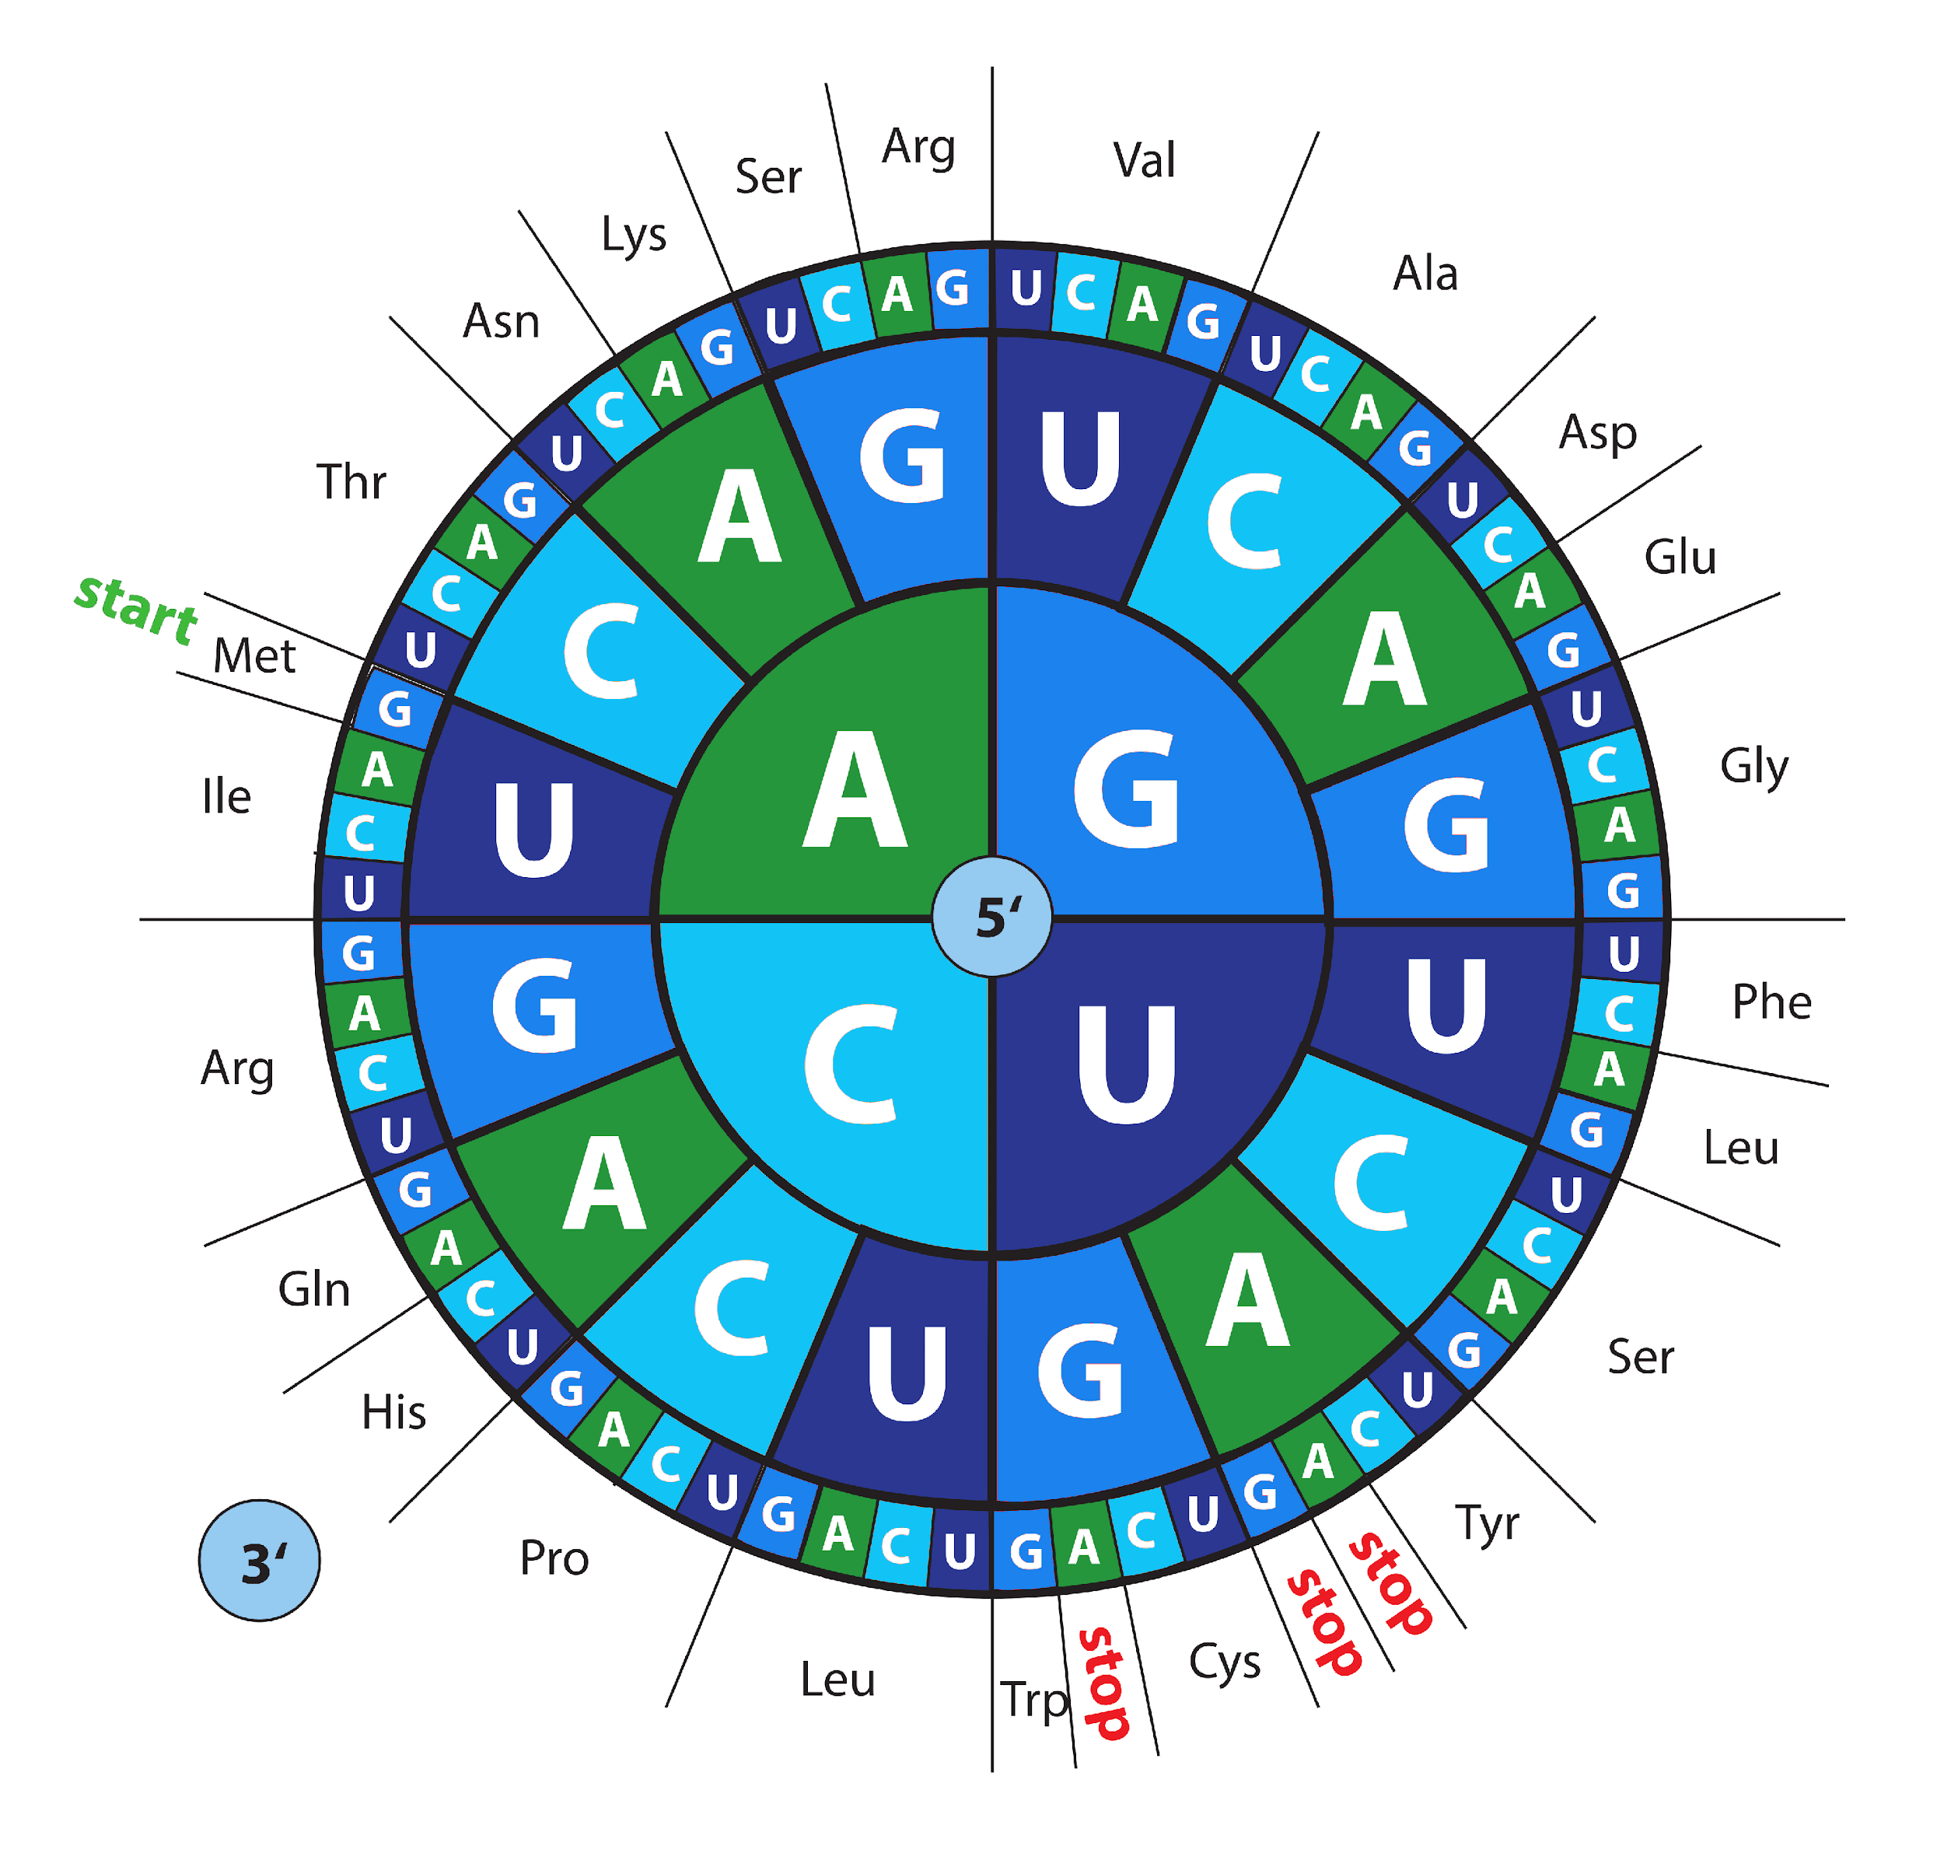
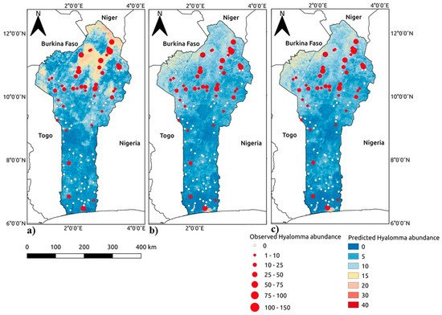
Examples of computational biology problems
Applying complex models to large datasets

Slide 27
Why do YOU want to learn computational biology?
Coding as a skill
Essential for independent research in biology (or any STEM field)
Massively expand your job prospects
Get things done faster and more efficiently
Be a different kind of scientist

Slide 28
Be a different kind of scientist
 | Empirical biologist | Computational biologist
Length of papers | Long (usually) | Very short (often)
How to get citations | Make an important finding | Make a useful tool
How you spend your research time | Writing papers, analyzing data, writing grants | Writing code, writing grants
How to get famous | Be prolific | Help people use your useful tool

Slide 29
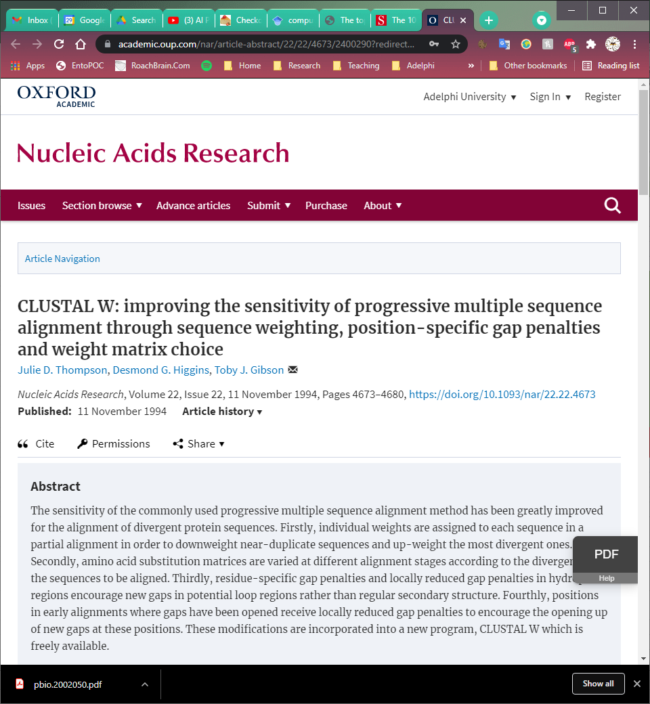
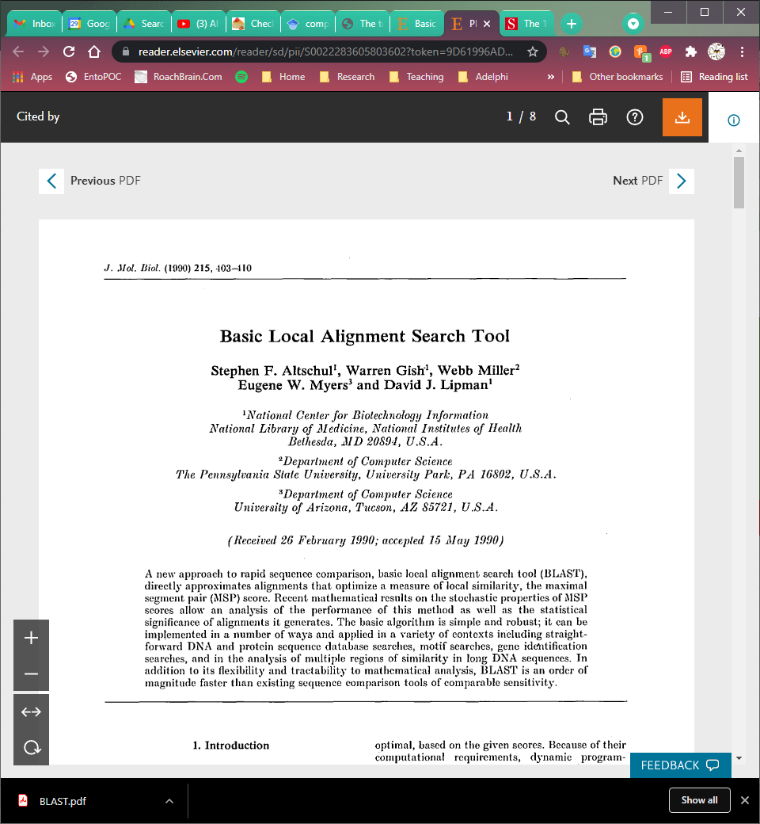
Some of the biggest computational biology papers
63,875 citations (Aug. 2021)
8 pages
As of 2014 this was the 12th highest cited paper in all of science.
https://www.nature.com/news/the-top-100-papers-1.16224
40,289 citations (Oct. 2014)
8 pages
As of 2014 this was the 10th highest cited paper in all of science.
https://www.nature.com/news/the-top-100-papers-1.16224

Slide 30
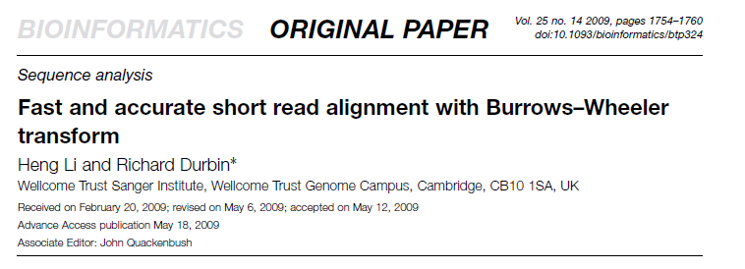
Some of the biggest computational biology papers
29,809 citations (Aug. 2021)
7 pages

Slide 31
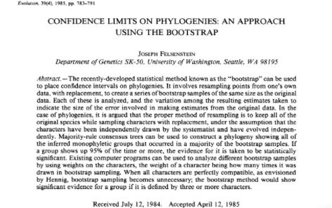
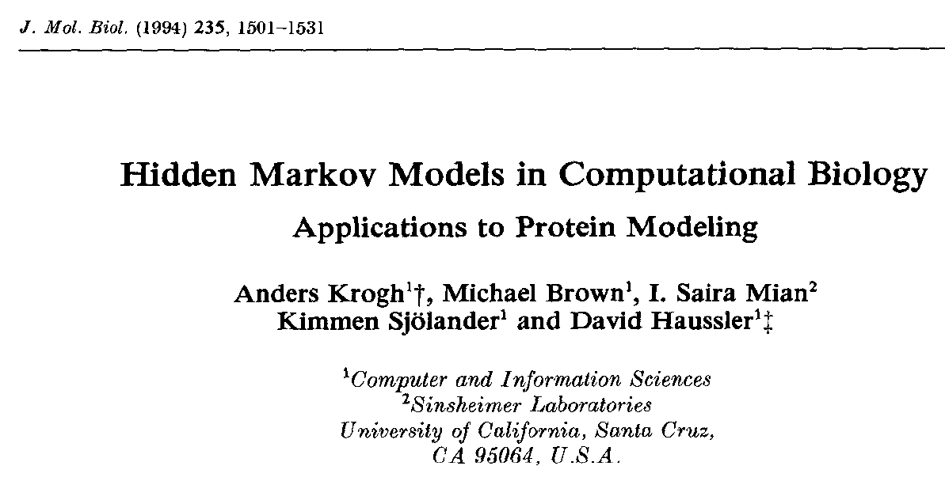
Some of the biggest computational biology papers
44,292 citations (Aug. 2021)
8 pages
As of 2014 this was the 41st highest cited paper in all of science.
https://www.nature.com/news/the-top-100-papers-1.16224
Review paper
2,612 citations (Aug. 2021)
31 pages

Slide 32
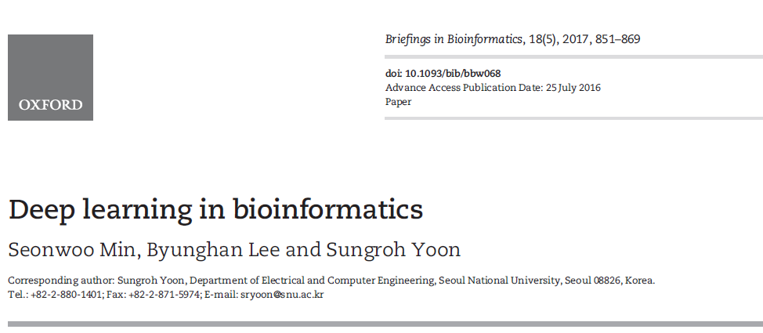
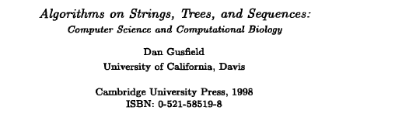
Some of the biggest computational biology papers
Review paper
942 citations (Aug. 2021)
19 pages
Textbook
7465 citations (Aug. 2021)

